Slide 1
Organizational Applications in the Legal Environment (A Look at the 7 Habits of Highly Effective People)
By
John Besselman

Slide 2
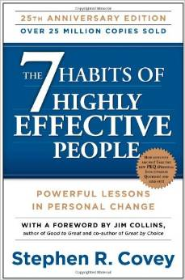

Slide 3
Foundational Support
Character vs. Personality Ethic (schools)
Power of the Paradigm
Habit Formation
Maturity Continuum
P/PC formula

Slide 4
Character vs. Personality (Schools of Thought on Leadership)
Character school of thought rests on traits and values of person.
Personality school of thought arose right after WWI and continues, to a degree, today.
Covey adopts wholly the Character School of Though (though sees the occasional utility in Personality-derived tools for short-term gain).
Dale Carnegie “How to Win Friends and Influence People” model

Slide 5
Personality Traits
Character
Traits
(based on principles)

Slide 6
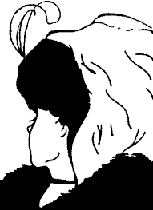
Power of the Paradigm
“Seasoned Woman” vs. Young Woman drawing

Slide 7
Habit Formation
Knowledge
Desire
Skill
Habit Creation

Slide 8
Maturity
Continuum
Interdependence
“We do it.”
Independence
“I do it.”
Dependence
“You do it.”

Slide 9
P/PC Formula
P
roduction
/
PC

Slide 10
Three Assets
Physical
Financial
Human

Slide 11
Interdependence
5
6
Public
Victory
4
Independence
3
Private
Victory
1
2
Dependence

Slide 12
Habit One – Be Proactive
Are we subject to our conditions? (1) Genetic - ancestral control (2) Psychic – mental control (3) Environmental – product of our surroundings

Slide 13
Victor Frankl Story
Our Input
This is the area we can control.
Stimulus
“Stuff Happens”
Response

Slide 14
Proactive Model (Act or be Acted Upon)
Reactive Statement Proactive Statement
There is nothing I can do. I have not practical alternative.
I can’t do that. I won’t do that.
I have to do that. I decided to do that.
How often do we communicate to our client (or other) in a reactive way?
Do we have to?

Slide 15
Personal
Arena
Circle of Concern
Circle of Influence
New Boss
Health
Pending
Legislation
Hobbies
Promotions
Relationships
Vacations
Professional
Arena
Trust Issues
with the Client

Slide 16
Circle of Concern
Circle of Influence

Slide 17
Circle of Concern
Pending
Legislation
Circle of Influence
Relationships
New Boss
Health
Hobbies
Trust Issues
with the Client
Vacations
Promotions

Slide 18
Proactive Steps (Expand Your Circle of Influence)
The “Haves” and the “Bes” If the problem is “out there” the thought is the problem. “Things will be better when I have a big house.” “I can be more thrifty with my expenditures.”
Proactive
Thought
Reactive Thought

Slide 19
Proactive Steps (Expand Your Circle of Influence)
The Other End of the Stick
Consequences
Mistakes
Making and Keeping Commitments
Be a light, not a judge
Be a model, not a critic
Be part of the solution, not part of the problem
Do we “own” our mistakes and shortcomings with our clients?
How easy is this to do?
Does your client think of you as a critic?

Slide 20
Habit Two – Begin with the End in Mind
How do you want to be regarded by those attending your retirement (or funeral)?
All things are created twice (mentally then physically)

Slide 21
Mental Creation
Rescripting – Become your own creator
Do we—or our office—become the product of what others expect us to be? Goleman, et al, called this the “ought” self
Do we mentally create the self (or office) that we think we should be? Goleman identified as the “ideal” self

Slide 22
Mission Statement
Covey encourages the creation of a mission statement
Focus on what you want to be (or your office to be) and what you want to accomplish
Incorporate the principles/values upon which being and doing these things will be based

Slide 23
? -Centered Life
What have you centered your life on?
Spouse, work, money, social functions, self, family, pleasure, friend-enemy, etc.

Slide 24
? -Centered Life

Slide 25
Wisdom
Security
Guidance
Power

Slide 26
Wisdom
Security
Principles
Guidance
Power

Slide 27
Your Paradigm – or how you view the world.
Wisdom
Security
Principles
Guidance
Power

Slide 28
Principles
Paradigm
Mission
Statement

Slide 29
Habit Three – Put First Things First
Habit One puts the actor in charge
Habit Two begins the creation (mental)
Habit Three continues the creation (physical)
This is the day-to-day, moment-to-moment doing it

Slide 30
Time Management
Where we spend out time tells us about our priorities
We should use our goals and priorities to schedule our time
Caution – time should be managed in week chunks instead of daily chunks to allow for variance

Slide 31
Urgent Not Urgent
I
II
Not Important Important
III
IV

Slide 32
Quadrant I (Crisis)
Pressing Problems
Critical Deadlines
Catastrophe
Urgent and Important
Too Much Time =
Stress and Burnout

Slide 33
Urgent Not Urgent
I
II
Not Important Important
III
IV

Slide 34
Quadrant IV (Trivia)
Busy work
Some mail
Some phone calls
Pleasant Activities
Not Urgent and Not Important
Too Much Time =
Irresponsible Management

Slide 35
Urgent Not Urgent
I
II
Not Important Important
III
IV

Slide 36
Quadrant III (Interruptions)
Some mail
Some phone calls
Some meetings
Some reports
Not Urgent but Important
Too Much Time =
Short Term Focus

Slide 37
Urgent Not Urgent
I
II
Not Important Important
III
IV

Slide 38
Quadrant II (Prevention)
PC Activities
Relationship Building
Planning
Recreation
Not Urgent
but Important

Slide 39
Quad II Activities
Covey states this is where our mission statement has the greatest impact
Do not be “problem-minded” but rather, “opportunity-minded”
Learn to say “No” – move all available time into Quadrant II activities
Quadrant II activities are planned

Slide 40
Planning Quad II Activities
Plan for a “people” dimension
Effective vs. Efficient – our relationships with persons are gauged by effectiveness, not efficiency
Plans require flexibility
Schedule tool is a servant, not a master

Slide 41
Getting Started
(1) Identify your roles (spouse, parent, partner, lawyer, leader, supporter, etc.)
(2) Choose Goals for the Roles (at least some of these goals should reflect Quad II activities)
(3) Schedule
(4) Daily Adapting
What can you do in the next 15 minutes?

Slide 42
Delegation Authority
Delegate to time or delegate to people
Core of interdependence is to delegate to people

Slide 43
Type of Delegation
Gofer delegation – in which the delegator dictates and manages every step in the process
Stewardship delegation – greater investment in time that will yield much greater outcome

Slide 44
Stewardship Delegation
Desired Results - focus on what is to be done (and when); not how it us to be done
Guidelines - set broad boundaries of areas of operation but not so narrow that it becomes gofer delegation
Resources - identify those that are available
Accountability - explain the standards of performance
Consequences - success or failure will lead to what result

Slide 45
Private Victories
Begin With the End in Mind
Put First Things First
Be Proactive

Slide 46
Public Victory
Success with ourselves (or within our own organizations) before we can have lasting successes with others
Mastery over ourselves (Habits 1, 2 and 3) leads to independence
Public victories lead to interdependence

Slide 47
Emotional Bank Accounts
Relating with other persons requires that we have some common ground to exchange with them, or emotional bank accounts
One spends out of his or her account by being discourteous, dishonest, distrustful, cutting people off, ignoring people, arbitrary actions, betraying trust, or threatening

Slide 48
Bankrupt Account
Lack of trust leaves an organization that is filled with measured words
Tension is high
MFRs are plentiful
Politicking
Flexibility is gone
Goleman and Co. would call this a dissonant organization (Primal Leadership)

Slide 49
Trust

Slide 50
1) Understand the person
6) Apologize Sincerely and Immediately
2) Little Things Count
5) Demonstrate Personal Integrity
3) Keeping Promises
4) Clarify Expectations

Slide 51
Habit Four – Think Win-Win
Based on work of Getting to Yes by Roger Fisher and William Ury
Many people/organizations see world through a competition paradigm
Employees do what gets counted

Slide 52
6 Possible Outcomes
Win-Win: mutually beneficial
Win-Lose: only one party gets what they want
Lose-Win: capitulation (think Neville Chamberlain)
Lose-Lose: revenge driven
Win: winning party does not care what others want
Win-Win or No Deal: mutually beneficial or we seek elsewhere

Slide 53
Character
Win-Win
Agreements
Relationships
Integrity
Maturity
Abundance Mentality

Slide 54
Stewardship Delegation
Win-Win Agreements
Desired results
Guidelines specified about how those results are to be obtained
Resources used to accomplish the results
Accountability for action
Consequences of the evaluation of performance (good or bad)
Focus on Results

Slide 55
Precursors to Win-Win (in the organizational setting)
Trust
Abundance Mentality
Organizational Rewards Win-Win
Visible Rewards
Commitment from the Entire Organization – training, planning, communications, etc.

Slide 56
Abundance Mentality
There is enough for everybody
As opposed to the Scarcity Mentality
Share credit, power and profit
Does your worth come from comparative value?
Those involved in Abundance Mentality are excellent teammates

Slide 57
Relational Trust
High Emotional Bank Account needed
Respect is a natural bi-product
Differences can be effectively communicated
This can lead to a greater number of alternatives for solutions (Win-Win)

Slide 58
Habit Five – Seek First to Understand, Then to be Understood
This habit requires diagnosis (to understand)
Diagnosis requires effective listening
We spend years learning how to read, write and speak, but not how to listen
“Intent to reply” is how most of us listen (formulating a response while the other person is speaking)
This is listening through our own paradigm

Slide 59
“Empathic Listening”
Listening with the intent to understand
Professionals need to understand the needs, concerns and situation before recommending a course of action…this requires empathic listening
4 levels of competencies

Slide 60
4 Level of Competency
Mimic Content
Rephrase the Content
Reflect the Feeling
Rephrase the Content & Reflect the Feeling

Slide 61
Paradigm Check Point
Pre-existing prejudices (young woman vs. old woman in picture)
I’m spouse-centric while you are work-centric
I am of the Scarce Mentality and you are of the Abundance Mentality
I am Right Brain holistic while you are Left Brain analytical

Slide 62
Habit Six – Synergize
Synergy = the whole is greater than the parts, or the real definition of a team
Trust is an indispensable element
Diversity of viewpoint is an indispensable element

Slide 63
Competition Paradigm
Too many adopt the win-lose outlook
Can you identify internal competitions in your agency?
Are you ever in competition with your client?

Slide 64
Reversion to the Norm
Restraining Forces and Driving Forces
Bureaucracies generate powerful Restraining Forces
Individuals and small groups can generate Driving Forces

Slide 65
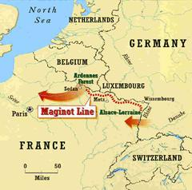
Trust Issues
Low Trust Environment is a defensive environment
CYA, MFR, email follow-ups and stilted conversations
Communication is curtailed

Slide 66
From “Speed of Trust”
“When leaders fundamentally don’t believe people can be trusted, they create a system and structures that reflect that belief, such as hierarchy, multiple layers of management, and cumbersome processes.”
-Stephen M.R. Covey-

Slide 67
Driving Forces
Personal Initiative
Inspiration
From the Top
Book We Just Read
Friends Are Going to Help
Boss Said To Do It
Restraining Forces
Q. Where does your office sit?
Q. What role does it play in overcoming the obstacle?
“We’ve never done that before.”
“Who said?”
“The Directive is interpreted to prohibit…”
“We don’t do it that way”

Slide 68
The “agency” Death
Over time, Restraining Forces win out
Increase Driving Force or reduce Restraining Force
Synergy works to reduce Restraining Force

Slide 69
Diversify
Value differences in the environment
No team made up of just punters
Every NFL team has a punter
Every NFL team has a place kicker
Some NFL teams have a kick-off kicker
Why?

Slide 70
Habit 7 – Sharpening the Saw

Slide 71
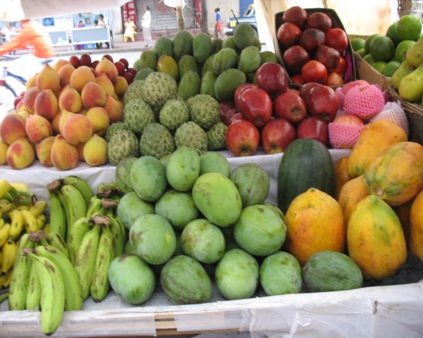
Four Dimensions of Renewal
Physical
Nutrition
&
Exercise
Mental
Spiritual
Quad II
Activity
Social/Emotional

Slide 72
Four Dimensions of Renewal
Physical
Habit Two: Begin with the End in Mind
Serving others leads to centered-existence
Mental
Spiritual
Social/Emotional

Slide 73
Four Dimensions of Renewal
Physical
Challenge your mind!
Mental
Spiritual
Social/Emotional

Slide 74
Four Dimensions of Renewal
1 Hour a Day
Physical
Emotional
Domain
Mental
Intellectual
Domain
Spiritual
Social/Emotional

Slide 75
Four Dimensions of Renewal
Physical
Mental
Spiritual
Social/Emotional

Slide 76
Four Dimensions of Renewal
Habits 4, 5 and 6 Are Emotional-centric
Physical
Habit 4: Think Win-Win
Our social and emotional renewal comes from living our values every day.
Habit 5: Seek First to Understand
Mental
Habit 6: Synergize
Spiritual
Social/Emotional

Slide 77
Organizational Renewal
Physical renewal is typically financial but can also include employee wellness programs
Spiritual renewal can include re-inspiration of the employee to engage the agency mission
Mental renewal is the opportunity to take on news challenges and training
Social-emotional renewal is dependent on the employees’ sense of justice

Slide 78
Concluding Thoughts

